Slide 1
Test Batsman Data Analysis using Python
Group Members
Saidur Rahman | 2014-1-60-067
MD. Farhan Tanvir | 2014-2-60-124
S. M. Ruhul Kabir Howlader | 2014-2-60-089
Al-Amin | 2014-2-60-061

Slide 2
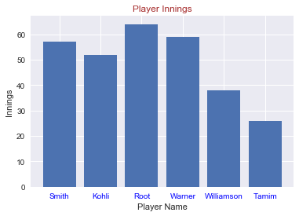
Identify the players by their data
Player No | Player Name | Country | Innings Played | Reference
1 | Steven Smith | Australia | 57 | 1
2 | Virat Kohli | India | 52 | 2
3 | Joe Root | England | 64 | 3
4 | David Warner | Australia | 59 | 4
5 | Kane Williamson | New Zealand | 38 | 5
6 | Tamim Iqbal | Bangladesh | 26 | 6

Slide 3
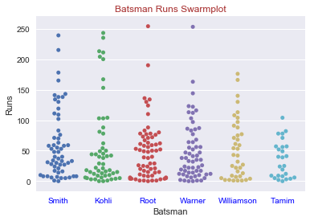
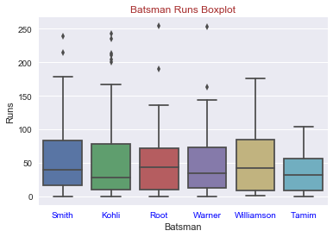
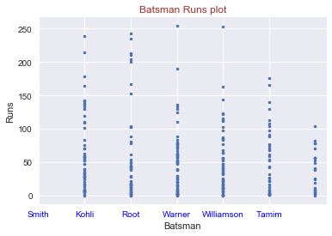
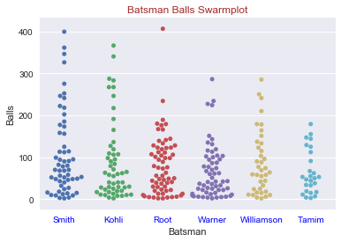
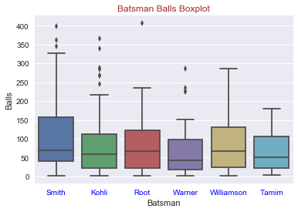
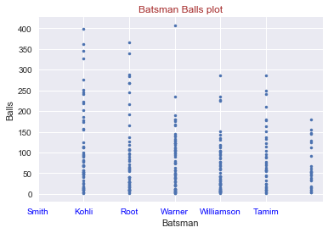
All player runs and balls visualization:

Slide 4
All players all innings score

Slide 5
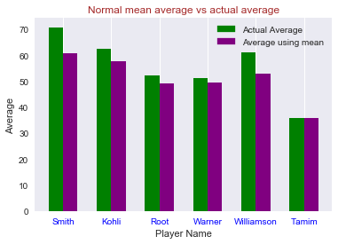
Comparing the player average runs

Slide 6
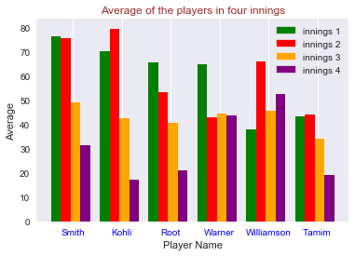
Comparing the player average runs in four innings

Slide 7
All players run in Boundaries

Slide 8
All players present in the ground status

Slide 9
The plot of runs and balls

Slide 10
Pearson correlation coefficient between runs and mins
Player Name | Value | Player Name | Value
Steven Smith | 0.969651823506 | David Warner | 0.961165930603
Virat Kohli | 0.984947389911 | Kane Williamson | 0.966798066549
Joe Root | 0.976154069449 | Tamim Iqbal | nan

Slide 11
Players strike rates

Slide 12
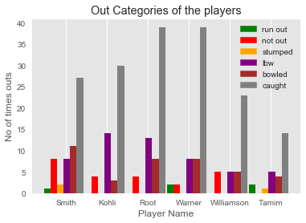
Players out Categories

Slide 13
All player normal distribution figures

Slide 14
All player normal and t distribution with 90% confidence interval
Player Name | t- distribution |  |  | Normal distribution
 | Mean | Lower Value | Upper Value | Mean | Lower Value | Upper Value
Steven Smith | 60.88 | 51.09 | 70.66 | 60.88 | 51.29 | 70.46
Virat Kohli | 57.56 | 45.04 | 70.07 | 57.56 | 45.32 | 69.79
Joe Root | 49.08 | 41.29 | 56.87 | 49.08 | 41.43 | 56.73
David Warner | 49.41 | 41.16 | 57.65 | 49.41 | 41.32 | 57.49
Kane Williamson | 53.03 | 42.55 | 63..50 | 53.03 | 42.87 | 63.18
Tamim Iqbal | 35.77 | 27.97 | 43.61 | 35.77 | 28.29 | 43.25

Slide 15
Thank You!!

